Slide 1
Using the RAICF Toolkit
From Self-Assessment to 90-Day Action Plan
2026 Bay Area UASI AI and Cybersecurity Project
How to use the Framework, Assessment Manual, Assessment Workbook, and 90-Day Action Plan playbook
A self-improvement process, not a formal audit, inspection, or compliance review.
Notes:
Welcome. This session walks through the toolkit files in the order you will use them: the Framework for orientation, the Manual as your reference, the Workbook for scoring, and the 90-Day Action Plan playbook for turning scores into work. The example workbook contains test data only.

Slide 2
The Toolkit at a Glance
Bay Area UASI
Six files, one repeatable improvement process
Word
Word
Excel
Excel
Word
PowerPoint
Regional AI Cybersecurity Framework (RAICF)
Assessment Manual
Assessment Workbook
Workbook: Test Data Example
90-Day Action Plan Playbook
LOE Slide Template
The guide. Explains the process, common gaps, strategies, and supporting worksheets.
The reference. All 137 controls with objectives, audit questions, evidence, and crosswalks.
The scoring tool. Mark scope, pick a 0-5 score, and the Dashboard builds itself.
A completed sample showing what a finished workbook and Dashboard look like.
The tasker menu. Ten taskers per Line of Effort for each of five maturity bands.
A one-page briefing view of the plan: four Lines of Effort, six taskers each, by 30-day phase.
Start here
Keep open while scoring
Fill this in
Practice and compare
Build your plan
Brief leadership
A self-improvement process, not a formal audit, inspection, or compliance review.
2
Notes:
The Manual is the authoritative source for control text. The Workbook is the execution artifact for scoring, filtering, and dashboarding. The RAICF adds only the regional layer: common gaps, shared strategies, and lightweight tools. It does not replace frameworks a jurisdiction already runs.

Slide 3
How the Files Work Together
Bay Area UASI
The RAICF recommended workflow, with the file you use at each step
1
2
3
4
5
›
›
›
›
Complete the Self-Assessment
Review Common Gaps
Select Strategies
Build a 90-Day Action Plan
Reassess and Repeat
Workbook + Manual
RAICF
RAICF
Playbook + LOE Slide
Workbook
With the Manual open as reference
Section 2, compared to your Dashboard
Section 3, by control type
Taskers by LOE band, summarized on the LOE slide
Re-score and compare to baseline
Designed to Be Repeated
90 Days Is a Planning Tool
Short, focused cycles. Choose a cadence that fits: quarterly, semi-annually, or aligned to budget and planning cycles.
Not a mandatory deadline. Adjust for staffing, funding, approval cycles, and complexity.
A self-improvement process, not a formal audit, inspection, or compliance review.
3
Notes:
Each cycle builds on the last. Completed actions are verified and closed, deferred actions are re-prioritized, and controls at an acceptable maturity level shift from improvement to maintenance.

Slide 4
Navigating the Framework (RAICF)
Bay Area UASI
A strategic regional overlay: use it alongside, not instead of, what you already have
Section | What You Will Find | Use It When
1. Where to Start | The five-step workflow | Orienting your team
2. Common Gaps | Gap patterns by control type | Comparing your results to regional patterns
3. Strategies | Regional and local actions per Line of Effort; threat-informed scenarios | Choosing what to work on
4. Self-Assessment | Worked example of reading the Dashboard | Interpreting your output
5. Responsible AI Use | Principles, risk screening factors, material change triggers | Reviewing a new or changed AI use
Appendices A-C | Domains, types, and maturity model; Threat Scenario Worksheet; Minimum AI Use-Case Record | Building inventories, exercises, and playbooks
Attachments 1-2 | External benchmark and references; open playbooks and tools | Looking for free implementation resources
First focus: visibility. Know which AI services are in use, who owns them, what data they handle, what they can reach, and how to disable or replace them.
A self-improvement process, not a formal audit, inspection, or compliance review.
4
Notes:
The RAICF addresses three concerns: attacks against AI systems, attacks enabled by AI, and failures or misuse of AI with security or operational consequences. It does not provide legal advice.

Slide 5
The Assessment Manual: Your Reference
Bay Area UASI
Domains provide structure. Control types provide behavior.
137
Score | Level | What It Means
0 | Nonexistent / N/A | Control is absent or not evidenced.
1 | Initial / Ad Hoc | Control exists informally or inconsistently.
2 | Defined | Documented, but implementation is inconsistent.
3 | Implemented / Repeatable | Consistently implemented and supported by evidence.
4 | Managed / Measured | Effectiveness is measured, reviewed, and reported.
5 | Optimized | Continuously improved, automated where practical, proactive.
Controls
10
Domains
4
Hybrid Controls
Control types
Each control belongs to one domain but may perform more than one control type, such as Directive / Preventive.
A self-improvement process, not a formal audit, inspection, or compliance review.
5
Notes:
Domains: GOV, RISK, AILC, ASSET, IAM, PROTECT, DETECT, RESPOND, RECOVER, IMPROVE. Control types: Directive, Preventive, Detective, Corrective / Responsive. These four types are also the four Lines of Effort in the 90-Day Action Plan.

Slide 6
Reading a Control Entry
Bay Area UASI
Example: GOV-01 Governance Structure (Directive)
Field | How to Use It
Control Objective and Statement | What the control is meant to accomplish. Judge applicability from this, not from the name alone.
Audit Questions | Ask these of yourself. GOV-01: Are decision rights, accountabilities, and oversight activities assigned?
Evidence | What would demonstrate it. GOV-01: approved charter, meeting minutes, RACI documentation.
Testing Procedure | How an assessor would check: review documents, inspect records, sample recent decisions.
Crosswalks | ISO/IEC 27001, ISO/IEC 42001, NIST AI RMF, NIST SP 800-53 Rev. 5, California laws. Map to the program you already run.
Maturity Score (0-5) | Your answer. Record it in the Workbook.
Match by ID
Workbook rows and Manual entries share the same Domain, Control Type, Control ID, and Control Name.
When Unsure
Read the Manual entry before marking a control out of scope.
A self-improvement process, not a formal audit, inspection, or compliance review.
6
Notes:
Where no NIST SP 800-53 control corresponds, particularly for emerging AI-specific areas such as ethics, human oversight, or explainability, the Manual omits the field.

Slide 7
The Workbook: Self Assessment Tab
Bay Area UASI
137 rows, one per control. Two columns do the work.
A Domain | B Control Type | C Control ID | D Control Name | E In Scope (Y/N) | F Maturity Score | G POAM Notes | H POAM Due Date
GOV | Directive | GOV-01 | Governance Structure | Y | 2 - Defined | Charter pending approval | (date)
GOV | Directive | GOV-02 | Roles & Responsibilities | Y | 3 - Implemented / Repeatable
AILC | Directive / Preventive | AILC-03 | Intended Use & Misuse Definition | N
Illustrative entries only. AILC-03 is an example of a hybrid control type.
Column E: In Scope
Column F: Maturity Score
Columns G and H: Optional
Pick Y if the control applies to your organization, systems, data, or current or planned AI use. Pick N if not; no score is needed.
For every Y, pick the 0-5 level from the dropdown that reflects current implementation.
POAM notes and due dates are for your internal use: planned improvements, owners, target dates.
A self-improvement process, not a formal audit, inspection, or compliance review.
7
Notes:
Columns E and F use dropdown lists. Column I converts the selected score to a number automatically for the Dashboard; do not edit it. The assessment team primarily uses columns E and F.

Slide 8
Scoring Well
Bay Area UASI
Capture the current state, not the desired future state
Do
Avoid
Score what is implemented and consistently practiced today
When between two levels, choose the lower unless the higher is substantially and consistently met
Consider the whole organization, not one good example
Where practice varies by department, score the overall picture and add context in POAM Notes
Expect a mix of scores; accuracy makes the results useful
Scoring plans, purchases in progress, or intentions
Raising a score because a policy, product, or capability merely exists
Judging a control by its name alone
Marking a control out of scope without reading its Manual entry
Treating low scores as failures: it is not a pass/fail exercise
A self-improvement process, not a formal audit, inspection, or compliance review.
8
Notes:
Lower scores are useful. They identify where support, planning, or improvement may provide the greatest benefit.

Slide 9
The Workbook: Dashboard Tab
Bay Area UASI
Builds automatically from the Self Assessment tab. Example below uses test data only.
2.71
126
Overall maturity score
In-scope controls
What the Dashboard Reports
Average maturity, in-scope controls, and POAM items per domain
Overall score, POAM items, and overdue POAM items
Average and maturity band for each Line of Effort
The 0-5 scoring key
A self-improvement process, not a formal audit, inspection, or compliance review.
9
Notes:
Averages are scope-aware: only controls marked In Scope = Y are included. The test data workbook is not from any Bay Area jurisdiction and must not be read as regional findings.

Slide 10
From Dashboard to Decisions
Bay Area UASI
Reading the test data example the way the RAICF worked example does
Control Type / Line of Effort | Average Maturity | Maturity Band | In-Scope Controls
Directive (LOE 1) | 2.56 | 2 to 3 - Defined to Implemented | 50
Preventive (LOE 2) | 3.25 | 3 to 4 - Implemented to Managed | 44
Detective (LOE 3) | 2.22 | 2 to 3 - Defined to Implemented | 32
Corrective / Responsive (LOE 4) | 2.83 | 2 to 3 - Defined to Implemented | 30
Test data only. Hybrid controls count toward every control type they perform, so LOE control counts add up to more than the in-scope total.
Lowest Domains First
Bands Select Taskers
POAM Closes the Loop
DETECT (1.67) sits well below the 2.71 overall score: a clear priority.
Each LOE average places you in a band of the Action Plan playbook.
Overdue POAM items measure risk identified but not yet closed.
A self-improvement process, not a formal audit, inspection, or compliance review.
10
Notes:
The Dashboard is also the leadership briefing and re-assessment artifact. It is regenerated at each re-assessment so progress is visible on the same scale over time. Before returning a workbook, confirm every in-scope control has a score and review unusually high or low scores.

Slide 11
Review Gaps and Select Strategies
Bay Area UASI
RAICF Sections 2 and 3 are organized by the same four control types as your Dashboard
Control Type | Regional Priority Outcome | Evidence of Progress
Directive | AI tools have accountable owners, defined purposes, risk decisions, supplier expectations, and documented review responsibilities. | Current records; approved requirements; assigned ownership; action plans tied to control IDs.
Preventive | Data, identities, models, applications, interfaces, configurations, and suppliers are protected in proportion to risk. | Test results; access reviews; configuration evidence; contract terms; closed findings.
Detective | Important access, use, changes, degradation, misuse, and security events can be observed, reviewed, and escalated. | Log coverage; alert and review records; tested detections; monitoring and drift results.
Corrective / Responsive | Jurisdictions can report, contain, coordinate, communicate, restore, continue, and improve after AI-related incidents. | Exercise results; tested disablement or alternate process; incident records; corrective actions closed.
Not every common gap applies to you. Focus on gaps supported by your own results, operating environment, and risk priorities, and pick strategies that fit your maturity and resources.
A self-improvement process, not a formal audit, inspection, or compliance review.
11
Notes:
Section 3 pairs a regional strategy, what the region does together, with a response-enhancement pattern, what a local government adopts. Section 3.5 is the one-page summary.

Slide 12
Building the 90-Day Action Plan
Bay Area UASI
Four Lines of Effort x five maturity bands, ten taskers in each
1
2
3
4
5
›
›
›
›
Score
Select
Sequence
Assign
Re-assess
Workbook
Playbook
Playbook
LOE Slide
Workbook
Average maturity for each LOE, from the Dashboard
Matching band; choose 5-7 of the ten taskers per LOE
Suggested phases: Days 1-30, 31-60, 61-90
Owner and completion criterion; record on the LOE slide
At day 90, re-score affected controls and plan again
Repeat the cycle
Band | Transition | 90-Day Focus
0 to 1 | Nonexistent to Initial | Establish the foundation: name owners, create first artifacts
1 to 2 | Initial to Defined | Formalize and document informal practices
2 to 3 | Defined to Implemented | Implement consistently and generate evidence
3 to 4 | Implemented to Managed | Measure and manage: metrics, reporting, validation
4 to 5 | Managed to Optimized | Optimize and automate; proactive improvement
A self-improvement process, not a formal audit, inspection, or compliance review.
12
Notes:
A jurisdiction may sit in different bands for different Lines of Effort. The Controls Covered column in each tasker lists the control IDs the work advances, so progress traces directly to re-assessment scores. Some taskers cite controls from adjacent domains because of hybrid control types.

Slide 13
Worked Example: Score to Taskers
Bay Area UASI
Test data: Detective (LOE 3) averages 2.22, so use the LOE 3 "Score 2 to 3" tasker list
Tasker (from the playbook) | Phase | Controls Covered | Owner | Completion Criterion
Tune and validate SIEM correlation rules | Days 1-30 | DETECT-09, DETECT-02 | You assign | You define
Achieve full EDR coverage with compliance reporting | Days 1-30 | DETECT-04 | You assign | You define
Operationalize consistent alert monitoring | Days 31-60 | DETECT-03, DETECT-08 | You assign | You define
Enforce log integrity and verify coverage | Days 31-60 | DETECT-14, DETECT-01 | You assign | You define
Stand up AI model monitoring dashboards | Days 61-90 | DETECT-10, DETECT-16, AILC-09 | You assign | You define
Completion Criterion
Repeat for Each LOE
The evidence that would satisfy an assessor that the tasker is done.
In the same example, Preventive (3.25) draws from the "Score 3 to 4" list instead.
A self-improvement process, not a formal audit, inspection, or compliance review.
13
Notes:
Taskers are written generically so any jurisdiction can execute them regardless of tooling. Jurisdictions may re-phase based on resources. Five of the ten LOE 3 taskers for this band are shown.

Slide 14
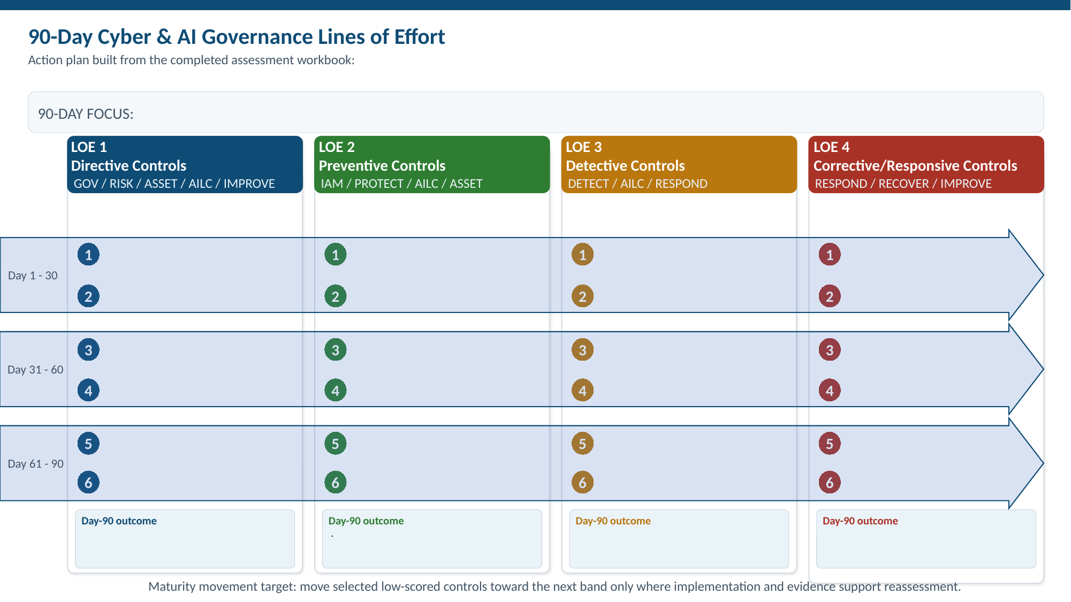
The LOE Slide Template: Briefing the Plan
Bay Area UASI
One slide that shows leadership the whole 90-day plan at a glance
How to Fill It In
Write the 90-Day Focus line. In each LOE column, enter the six taskers you selected, two per 30-day phase, and state the Day-90 outcome.
Where It Comes From
Taskers come straight from the playbook band for each LOE. Domains under each LOE header match the Assessment Manual.
Template as delivered, before a jurisdiction fills it in
A self-improvement process, not a formal audit, inspection, or compliance review.
14
Notes:
The template holds six taskers per Line of Effort, which matches the playbook guidance of five to seven per LOE for a realistic 90-day load. Use the same slide at day 90 to report what was completed, and again for the next cycle. The bottom line reminds leadership that maturity moves only where implementation and evidence support reassessment.

Slide 15
Supporting Tools in the Framework
Bay Area UASI
Optional aids for inventories, exercises, reviews, and testing
Minimum AI Use-Case Record (Appendix C)
Threat Scenario Worksheet (Appendix B)
The fields for an AI inventory entry: identification, purpose and users, data, technology and access, review and testing, operations, continuity and retirement.
Turns a scenario into targeted control testing, monitoring requirements, exercise injects, and a response playbook.
Risk Screening for Elevated Uses (Section 5.1)
Open Playbooks and Tools (Attachment 2)
Seven factors: data, people and decisions, access and exposure, authority and autonomy, operational dependence, reversibility, supply chain.
Free resources mapped to control types and domains. Get authorization first, test in isolation, validate findings, and map them to existing control IDs.
A self-improvement process, not a formal audit, inspection, or compliance review.
15
Notes:
Inclusion of a tool is informational and is not an endorsement or evidence that a control is satisfied. Do not send protected data to a tool or external model unless the data path, retention, and provider terms are understood. Do not create a parallel maturity score from tool output.

Slide 16
Getting Started
An honest baseline first. Then short, focused cycles that build on each other.
This Week
This Month
This Quarter
Read RAICF Section 1. Open the test data workbook to see a finished example.
Complete the Workbook with the Manual open. Review the Dashboard and save.
Pick taskers by LOE band, fill in the LOE slide, assign owners and completion criteria, then re-score at day 90.
Questions and Discussion
A self-improvement process, not a formal audit, inspection, or compliance review.
Notes:
The timeframes on this slide are suggestions only; the framework lets each organization choose its own cadence.

