Slide 1



BAY AREA UASI
CYBER BRIDGE 2026 Tabletop Exercise
Welcome to today’s exercise, we will get started soon.

Slide 2

ADMINISTRATIVE REMARKS
Safety information
Restrooms
Food / Drinks
Breaks and lunch
Microphones
WIFI
Notes:
Drinks and food details
WIFI
Intro?

Slide 3
HOST WELCOME MESSAGE
Notes:
Ask participants to identify what discipline they are from: IT, EM, Government, Contractors, Etc.

Slide 4
EXERCISE SCHEDULE
CONTENT
Time | Activity
9:30 AM - 10:00 AM | Welcome and Exercise Overview
10:00 AM - 11:00 AM | Module 1-Early Indicators
11:00 AM - 12:00 PM | Module 2-Emerging Regional Impacts
12:00 PM - 1:00 PM | Break/Lunch
1:00 PM - 2:00 PM | Module 3-Information Integrity Crisis
2:00 PM - 2:45 PM | Hot Wash
2:45 PM - 3:00 PM | Closing Comments/Adjourn

Slide 5
EXERCISE PURPOSE
Cyber Bridge 2026 will evaluate the region’s ability to:
Share information across jurisdictions
Maintain a common operating picture
Make coordinated operational decisions
Respond to cascading cyber impacts
Notes:
is to examine regional coordination, communications, operational decision-making, and cybersecurity response actions during an AI-enabled cyber incident affecting multiple Bay Area jurisdictions and partners.

Slide 6
OBJECTIVE #1
Assess the ability of participating jurisdictions and regional stakeholders to identify, validate, and share cyber threat intelligence, indicators of compromise, and situational awareness information across agencies within established coordination processes during an escalating AI-enabled cyber incident affecting multiple Bay Area jurisdictions.
Core Capability: Intelligence and Information Sharing

Slide 7
OBJECTIVE #2
Evaluate the ability of participating organizations to coordinate regional operational response actions, including executive notifications, resource prioritization, cross-jurisdiction coordination, and decision-making processes, in response to cascading cyber impacts affecting critical services, infrastructure, and public operations.
Core Capability: Operational Coordination

Slide 8
OBJECTIVE #3
Evaluate the ability of participating organizations to implement internal and external communications procedures, including leadership notifications, interagency coordination, mission partner engagement, and public information considerations, during a rapidly evolving cyber incident involving AI-enabled threats and operational disruptions.
Core Capability: Operational Communications

Slide 9
OBJECTIVE #4
Assess the ability of participating jurisdictions and regional partners to analyze and implement cybersecurity response, continuity, and recovery actions aligned with the NIST Cybersecurity Framework functions of Identify, Protect, Detect, Respond, and Recover during a coordinated cyberattack targeting regional systems, infrastructure, and public services.
Core Capability: Cybersecurity

Slide 10
EXERCISE GUIDELINES
This is an open no-fault environment. Varying viewpoints are expected and open discussion is encouraged.
Base your responses on the existing plans and capabilities of your agency, organization or group.

Slide 11
EXERCISE GUIDELINES
Decisions are not precedent setting; consider different approaches and suggest improvements.
Issue identification is not as valuable as suggestions and recommended actions that could improve regional coordination.

Slide 12
EXERCISE ROLES
Facilitators
Evaluators
Support Staff
Players
Observers
Notes:
Facilitators, Evaluators, Support Staff, Players

Slide 13
EXERCISE DOCUMENTATION
Exercise materials are available digitally.
During check-in you were sent an email with a link to an exercise page for you.
  Check your junk folder if you did not get it.
  There is also a link to that page in the printed Sitman.
On that webpage you can find the following documents:
  Situation Manual (Sitman).
  Scenario Inject Cards.
  Pre-Exercise read-ahead materials.

Slide 14
EXERCISE INSTRUCTIONS
Facilitators will deliver scenario cards and video injects; you can also find them on DrillDeck through the link.
The exercise room has been divided into county groups and regional “pods” to promote neighbor-to-neighbor discussions.
You are encouraged to discuss issues and impacts with your neighboring or similarly impacted groups.

Slide 15
EXERCISE INSTRUCTIONS
Collecting information from all players is a critical component of the exercise.
Each group should identify a data entry player; you can rotate this position if you wish.
Data entry is VERY subjective; don’t stress over details about the nature of the cyber incidents, it might change overtime.

Slide 16

ArcGIS Survey123
We are using Survey123 as a data collection tool for exercise play.
The data entered by each county group can be viewed via the live dashboard during the exercise and will be captured afterward for follow-up.
Links to both the survey and the dashboard are in the Sitman.

Slide 17
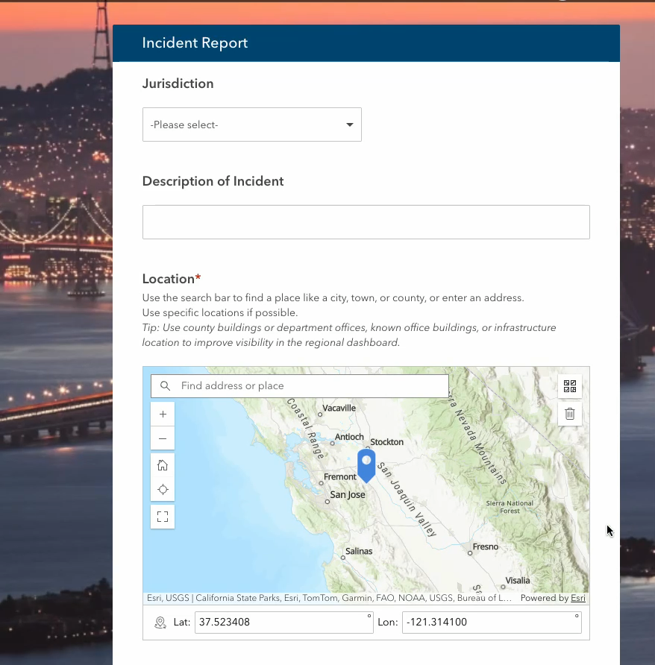

Slide 18
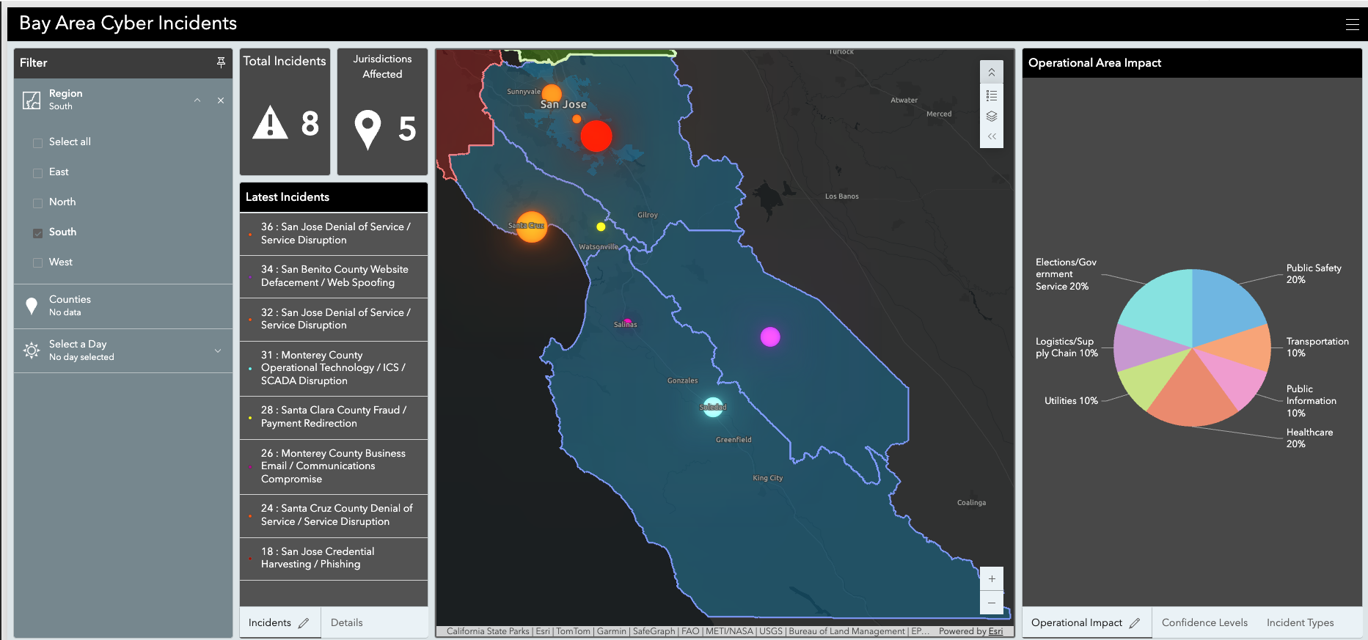
Display Dashboard
Display Dashboard

Slide 19
IMPORTANT SURVEY123 FIELDS
Operational Impact Areas
Impact Severity
Action Taken
Resource Requests

Slide 20
QUESTIONS
Are there any questions before we get started?

Slide 21
STARTEX

Slide 22

SCENARIO BACKGROUND
Tensions have been increasing between the United States and China following American restrictions on semiconductor exports, advanced computing technologies, and artificial intelligence systems.
A Chinese government-sponsored cyber group,
APT Dragon Typhoon, has quietly embedded
itself within Bay Area government and industry
networks.

Slide 23
SCENARIO BACKGROUND
APT Dragon Typhoon seeks multiple goals against the United States:
Demonstrate U.S. IT systems vulnerabilities
Undermine public cybersecurity confidence
Create political pressure and influence
Gather intelligence to steal models and advancements
Leverage and exploit AI as a force multiplier

Slide 27
VIDEO INJECT #1

Slide 28
MODULE 1 – EARLY INDICATORS
The items presented in the first grouping occurred in the days and weeks prior to today.
Location-specific scenario updates will now be provided to you by your facilitators.
The Situation Manual has some group discussion questions for Module 1 on page 10.

Slide 29
MODULE 1 – GROUP DISCUSSIONS
Spend the next 10-15 minutes discussing the situation and module discussion questions.
Group facilitators will be available to guide you if necessary.
Notes:
Add slide / section to input data into ArcGIS

Slide 30
MODULE 1 – POD DISCUSSIONS
With your POD groups, discuss the current situational impacts you are dealing with.
Discuss any issues that might have regional impacts and how they can be coordinated together.

Slide 31
MODULE 1 – DAY 1 UPDATE
Group facilitators will provide a scenario update when your groups are ready.
Discuss the module 1 questions with the updated scenario information presented.

Slide 32
MODULE 1 – POD REPORTS
North Bay
South Bay
East Bay
West Bay

Slide 33
10 MINUTE BREAK

Slide 34
MODULE 2

Slide 35
VIDEO INJECT #2

Slide 36



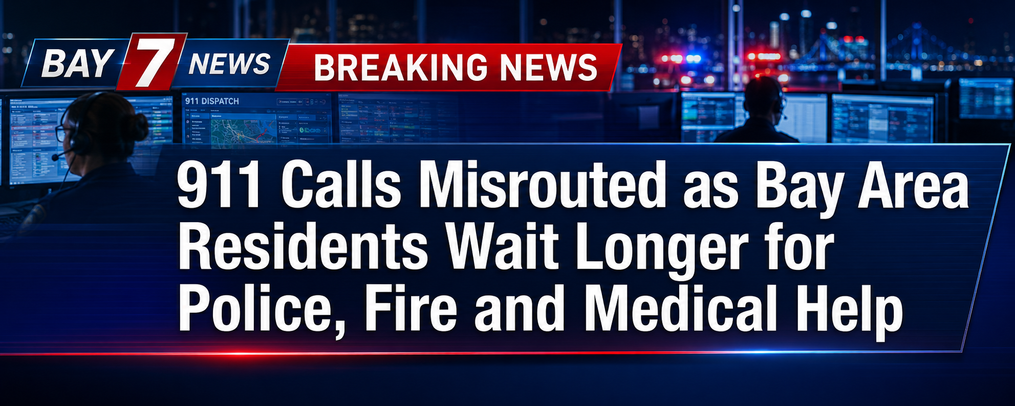
MODULE 2 – DAY 3 HEADLINES
Notes:
911 Calls Misrouted as Bay Area Residents Wait Longer for Police, Fire and Medical Help
False Evacuation Orders and Failed Emergency Alerts Leave Residents Unsure Where to Go
Transit Delays, Dangerous Detours and Stranded Drivers Spread Across Bay Area Roads
Food Supply Critical as Cyberattacks Disrupt Ports, Farms and Community Assistance Programs

Slide 37
MODULE 2 – REGIONAL IMPACTS
Facilitators will present your group with the Day 3 scenario update.
Discuss among your groups and review the Module 2 discussion questions.
Enter all updated impacts and resource needs into Survey123

Slide 38
MODULE 2 – DAY 5 UPDATE
Facilitators will provide your groups with Day 5 scenario updates.
Continue to discuss this update with your group.
Remember to update your Survey123 with any additional issues or impacted locations.

Slide 39
LUNCH BREAK

Slide 40
VIDEO INJECT – Deep Fake
Play BART Disruption video
Play Contra Costa Cyber-AI incident video

Slide 41
MODULE 3

Slide 42

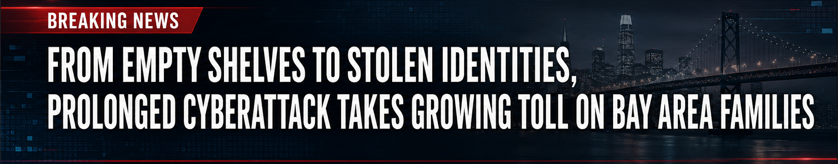
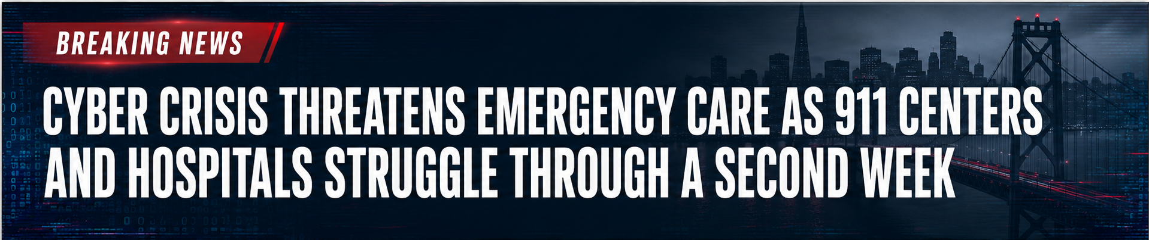

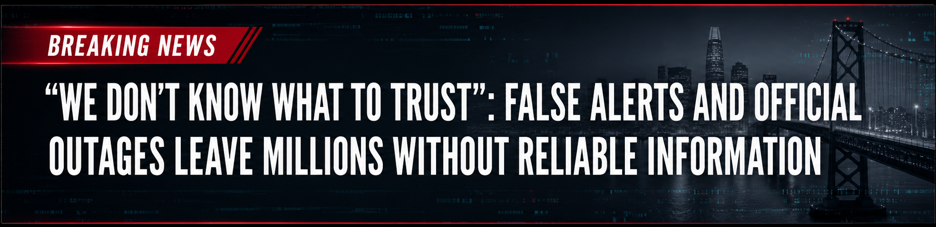
MODULE 3 – DAY 7 HEADLINES
Notes:
Bay Area’s Digital Breakdown Reaches Day Seven, Disrupting Nearly Every Part of Daily Life.
False Alerts and Official Outages Leave Millions Without Reliable Information.
Cyber Crisis Threatens Emergency Care as 911 Centers and Hospitals Struggle Through a Second Week.
From Empty Shelves to Stolen Identities, Prolonged Cyberattack Takes Growing Toll on Bay Area Families

Slide 43
MODULE 3 – DAY 7 UPDATE
Facilitators will provide your groups with Day 7 scenario updates.
Discuss the Module 3 questions with your groups.
Update Survey123 as needed.

Slide 44
MODULE 3 – DAY 12 UPDATE
Facilitators will provide your groups with the day 12 scenario updates.
Update Survey123 as needed.

Slide 45
VIDEO INJECT #3

Slide 46
ENDEX

Slide 47
Group Hotwash
Strengths
Areas for Improvement

Slide 48
Closing Comments & Remarks

Slide 49
Thank you!

Slide 50
TITLE
CONTENT

Slide 51
TITLE

